Slide 1
Lecture 3: HTML5 and CSS3
Dr. Shruti Bhilare

Slide 2
CSS Selectors

Slide 3
CSS Grid box
CSS Grid Layout (aka “Grid” or “CSS Grid”), is a two-dimensional grid-based layout system that, compared to any web layout system of the past, completely changes the way we design user interfaces.
CSS Flexbox is also a very great layout tool, but its one-directional flow has different use cases
They can stretch and shrink, they can center things, they can re-order things, they can align things
https://css-tricks.com/complete-guide-css-grid-layout/

Slide 4
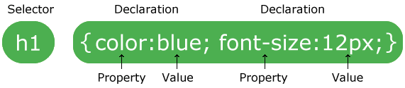
CSS rules
Composed of CSS rules, which define sets of styles in declaration block or CSS ruleset
selector {
property: value;
}

Slide 5
Where do the CSS rules go?
CSS can be added to HTML elements in 3 ways:
The most common and professional way to add CSS, is to keep the styles in separate CSS files.
External-separate style sheet
<head> <link rel="stylesheet" type="text/css" href="myStyles.css" /> <style> body { font-family: Tahoma, Arial, sans-serif; } </style> </head> <body> <div style="padding:2px; ... "> </body>
Internal-page specific, using <style>
Inline- element-specific, using style attribute

Slide 6
Selector type | Notations | Description
Element selector | p | All <p> elements
ID selector | #abc | element with id="abc"
Class selector | .abc | elements with class="abc"
Combinators Adjacent sibling combnator General sibling combinator Child combinator Descendant combinatory | A+B A ~B A> B A,B A B | Elements B direct sibling of A General sibling of A Direct child of A All A and B Type B descendant(s) of A
pseudo classes | :only-child :nth-child :first-child :last-child
pseudo elements | :first-line

Slide 7
Selector examples
Selector example | Meaning
p | All <p> elements
.abc | All elements with the abc class, i.e.
#abc | Element with the abc id, i.e. id="abc"
p.abc | <p> elements with abc class
p#abc | <p> element with abc id (p is redundant)
div strong | <strong> elements that are descendants of a <div>
h2, div | <h2> elements and <div>s
CSS Selectors practice

Slide 8
Grouping selectors (2 Common bugs)
p.abc vs p .abc
A <p> element with the abc class vs An element with the abc class that descends from <p>
p .abc vs p, .abc
An element with the abc class that descends from <p> vs All <p> elements and all elements with the abc class

Slide 9
Combining selectors
#main li.important strong {
color: red;
}
Q: What does this select?
A: Read from right to left:
<strong> tags that are children of <li> tags that have an "important" class that are children of the element with the "main" id.

Slide 10
Combinators
Descendant combinator (space separated)
target all instances of single element type that lie within another. eg.
article p {…}
Child combinator (use > operator)
target immediate child of parent
article > p {…}
Adjacent sibling (use + operator)
next to each other and having common parent
h2 + p {..}
General sibling combinator (use ~ operator)
having same parent (need not to be next to each other)
h2 ~ ul {…}

Slide 11
Pseudo-classes and elements
Pseudo-classes
:first-child, :last-child, :nth-child, :nth-last-child, :only-child
:first-of-type, div#introduction p:first-of-type::first-letter { }
:last-of-type
:disabled, :enabled, :checked
Pseudo elements:
::first-letter, ::first-line, ::before, ::after
E.g. div#introduction p:first-child {…}
Notes:
We can use :last-child to remove the border from the last list item, like so:
nav li:last-child {
border-right:0;
}
a[href="#top"]::after {
content:" \2191";
}

Slide 12
Pseudo-classes and pseudo-elements
What is the difference?
Purpose:
Pseudo-Classes: Apply styles based on an element's state or position in the document (e.g., :hover, :focus, :nth-child).
Pseudo-Elements: Apply styles to specific parts of an element or add content before or after an element’s content (e.g., ::before, ::after, ::first-line).
Syntax:
Pseudo-Classes: Use a single colon (:) (e.g., :hover).
Pseudo-Elements: Use double colons (::) (e.g., ::before, ::after).
Application:
Pseudo-Classes: Used for styling based on the user’s interaction or the element’s position.
Pseudo-Elements: Used for styling parts of an element or inserting content.

Slide 13
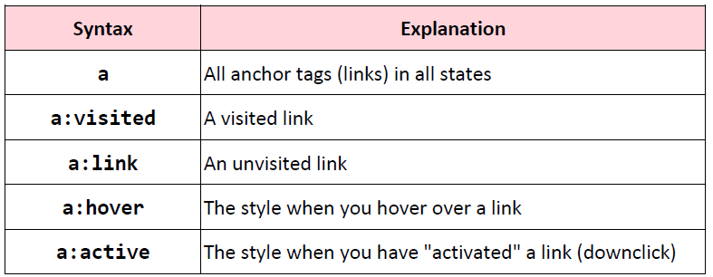
CSS pseudo-classes
Link-related CSS
How do we style visited links differently from unvisited?
pseudo-classes: special keywords you can append to selectors, specifying a state or property of the selector

Slide 14
More selectors
Attribute and substring selectors
style an element if a given attribute exists
selector[attribute]
input[required] {….}
input[type=“checkbox”] { …. }

Slide 15
Relative font sizes: percent em, rem

Slide 16
CSS distance units
How to specify distance units or font sizes in CSS?
Absolute
2px | pixels
1mm | millimeters
2cm | centimeters
0.2in | inches
3pt | printer point 1/72 inch
Relative
2em | 2 times the element’s current font size
2rem | 2 times the root element’s current font size
40% | 40% of the parent element’s size

Slide 17
Relative units
Whenever possible, it's best to use relative units (like percentage) instead of absolute units (like px).
Advantages:
More likely to work on different screen sizes
Easier to reason about; fewer magic numbers
10% / 80% / 10% vs 122px / 926px / 122px

Slide 18
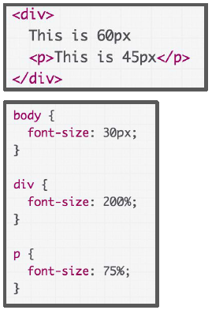
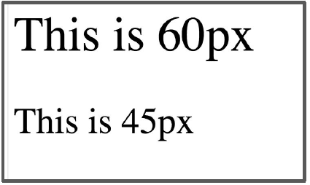
Percent is relative to the parent
p is 75% of its parent, which
is 200% of 30px.
p's size: .75*2*30 = 45px
https://codepen.io/sbhilare/pen/rNaXMbG

Slide 19
Relative font sizes: em
But instead of percentages, relative font sizes are usually defined in terms of em: - em represents the calculated font-size of the element - 1em = the inherited font size - 2em = 2 times the inherited font size
In other words, font-size: 1em; is the same as font-size: 100%;

Slide 20
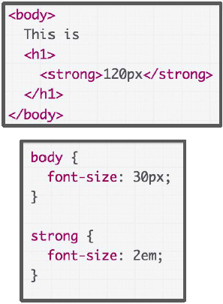
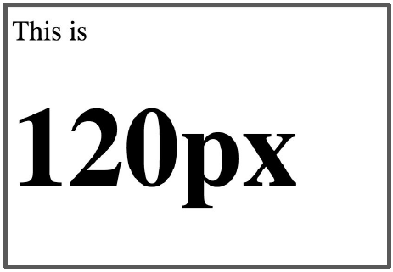
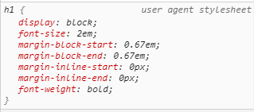
What is the size of <strong>? 120px or 60px?
In the Chrome Inspector, we see the default browser font-size for h1 is 2em. So it's 30*2*2 = 120px.
https://codepen.io/sbhilare/pen/ExaqNxE

Slide 21
Relative font sizes: rem
If you do not want your relative font sizes to compound through inheritance, use rem:
rem represents the font-size of the root element
1rem = the root (html tag) font size
2rem = 2 times root font size

Slide 22
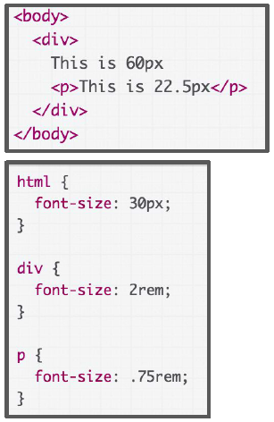
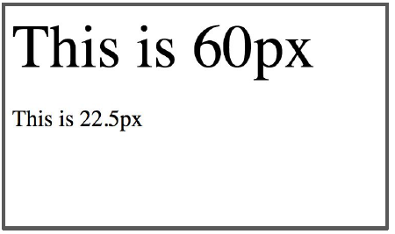
font-size is set on the html element, not body (or any other tag)
https://codepen.io/sbhilare/pen/MWYNbeE

Slide 23
Relative font conclusions
Use relative fonts for the same purpose as using relative heights and widths:
Prefer em and rem over percentages
Not for any deep reason, but em is meant for font so it's semantically cleaner
Use rem to avoid compounding sizes
In addition to font-size, consider em/rem for:
line-height
margin-top
margin-bottom

Slide 24
Responsive Web Design

Slide 25
Responsive Web Design: motivation
We want to write our CSS in a way that can look nice in a wide range of screen sizes:
27" desktop monitor
laptops
Tablets
Smartphones of varying sizes
Responsive web design responds to the needs of the users and the devices they're using.
The layout changes based on the size and capabilities of the device.
For example, on a phone users would see content shown in a single column view; a tablet might show the same content in two columns.

Slide 26
Responsive web design
Responsive web design can be achieved using
Meta viewport tag and
CSS media queries
Flexible layouts

Slide 27
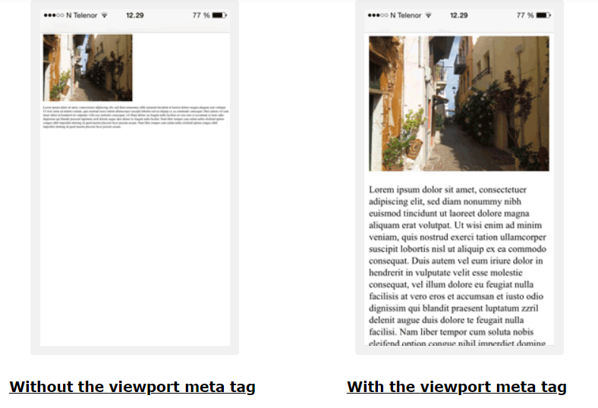
Meta viewport tag
Why Use <meta name="viewport">?

Slide 28
Meta viewport tag
To create mobile-optimized websites, use this tag
If not used, phone browser renders the webpage for larger “virtual” viewport (desktop width ~1000 px) and zooming out
Included in <head> section of your HTML.
<meta name="viewport" content="width=device-width, initial-scale=1">
name=viewport: "Browser, I am going to tell you how I want the viewport to look."
width=device-width: "The viewport's width should always start at the device's width." (i.e., no virtual viewport)
initial-scale=1: "Start at zoom level of 100%."
You should always include this tag in your HTML.

Slide 29
Media queries
a popular technique for conditional rendering based on the characteristics of the device:
mediatype: Styles can be specified for certain media types only such as for printed documents or for screen readers
All: Suitable for all devices.
Print: Intended for paged material and documents viewed on a screen in print preview mode.
Screen: Intended primarily for screens.
Speech: Intended for speech synthesizers.
mediafeature: test for a specific feature of the user agent or display device.
Width and height: width, height, min-width, max-width, min-height, max-height
Orientation: landscape | portrait
Resolution
For example, you can apply styles to only those screens that are greater, or smaller, than a certain width

Slide 30
Media queries
@media rule
inverts the meaning of an entire media query.
@media not|only mediatype and (mediafeature and|or|not mediafeature)
{ CSS-Code; }
combines a media feature with a media type or other media features.
prevents older browsers that do not support media queries with media features from applying the specified styles. It has no effect on modern browsers.
Mediatype
All: Suitable for all devices.
Print: Intended for paged material and documents viewed on a screen in print preview mode.
Screen: Intended primarily for screens.
Speech: Intended for speech synthesizers.
Mediafeatures: test for a specific feature of the user agent or display device.
Width and height: width, height, min-width, max-width, min-height, max-height
Orientation: landscape | portrait
Resolution
They are all optional. However, if you use not or only, you must also specify a media type.

Slide 31
Mobile-first approach to web development
Mobile First approach
Base styles: smaller screens
Media queries: Larger screens
Reason: mobiles generally have less memory, processing power and bandwidth than other devices
Use min-width in media-queries

Slide 32
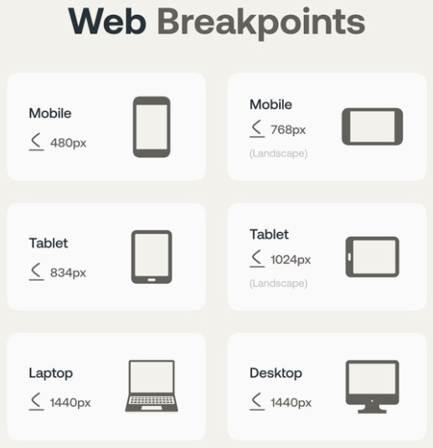
Typical breakpoints for media-queries

Slide 33
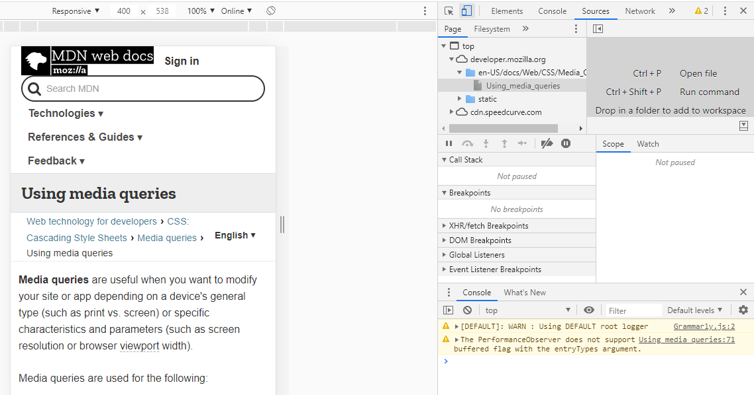
Chrome device mode
Chrome device mode for inspecting mobile layouts

Slide 34
Responsive Images
Using The width Property
If the width property is set to a percentage and the height is set to "auto", the image will be responsive and scale up and down:
img { width: 100%; height: auto; }
Using The max-width Property
If the max-width property is set to 100%, the image will only scale down if it has to, but never scale up to be larger than its original size:
img { max-width: 100%; height: auto; }

Slide 35
Responsive design summary
Always add the meta viewport tag
Use @media queries to add styles for devices with certain characteristics, such as screen width
Use flexible layouts such as flexbox and gridbox
Use the Chrome Device Mode to simulate mobile rendering on desktop
For height and width, prefer percentages
For fonts, prefer em and rem, vh and vw
For images, use max-width property

Slide 36
Cascade, Specificity and Inheritance
most fundamental concepts of CSS which control how CSS is applied to HTML and how conflicts are resolved.
cascade,
specificity, and
inheritance
Notes:
!important was created as a method to allow users with specific accessibility needs to override author styles. For example, it can be used to increase the font size or increase the contrast. Because of this, the !important flag should never be found in author style sheets

Slide 37
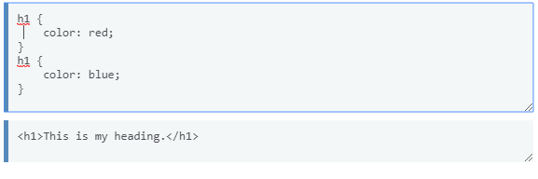
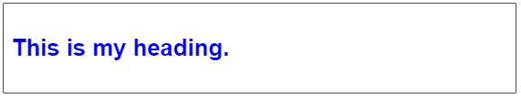
Cascade
The order of CSS rules matter; when two rules apply that have equal specificity the one that comes last in the CSS is the one that will be used.

Slide 38
Specificity of CSS rules
Specificity comes into play when two or more style rules apply to the same element and set the same property, with the same importance, in the same position in the cascade. In this case, the rule with the highest specificity is the winner
Four levels of specificity:
a = inline style (weight = 1000)
b = the total number of ID selectors (weight = 100)
c = the number of class and attribute selectors and pseudo-classes in the selector (weight = 10)
d = the number of type selectors and pseudo-elements in the selector (weight = 1)
!important
CSS to overrule all specificity calculations,
however you should be very careful with using it.
This is used to make a particular property and value the most specific thing, thus overriding the normal rules of the cascade.

Slide 39
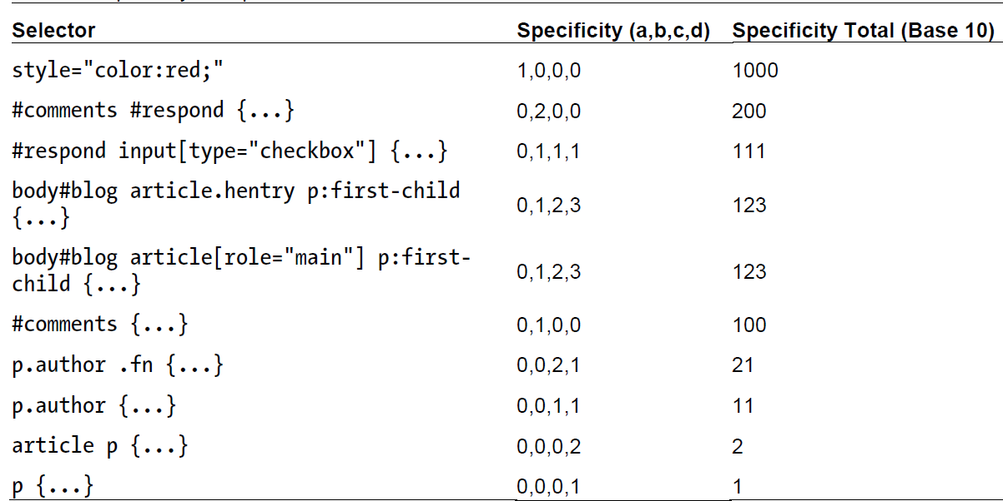

Slide 40
Inheritance
Most CSS styles are inherited from parent to child
Generally, text-related properties are inherited and layout-related properties are not.
Inherited properties: color and font-family on an element
Not inherited properties: width, margins, padding, and borders do not inherit.
You can override this style via specificity:

Slide 41
SEO
What is SEO?
Stands for search engine optimization
It’s a set of practices and techniques designed to improve a website’s visibility in search engine results pages (SERPs).
The goal is to increase organic (non-paid) traffic to the site by making it more appealing to search engines like Google, Bing, and Yahoo.
Decreasing the bounce rate
Bounce Rate: defined as the percentage of visitors that leave a webpage without taking an action, such as clicking on a link, filling out a form, or making a purchase.

Slide 42
Vocabularies
Collaborative community activity: mission to create, maintain, and promote schemas for structured data on the Internet, on web pages.
Example: Schema.org, FOAF vocabulary, Dublin core
Schema.org vocabulary
collection of schemas.
founded by Google, Microsoft, Yahoo and Yandex,
can be used with many different encodings, including RDFa, Microdata and JSON-LD.
These vocabularies cover entities, relationships between entities and actions
semantic information in the content can be conveyed in a way search engines can understand
Structured data testing tool/ Rich results test available

Slide 43
JSON for linking data (JSON-LD)
Based on Javascript object notation (JSON)
JSON-LD is a scripting language that allows publishers to communicate important information to search engines.
Data is messy and disconnected. JSON-LD organizes and connects it, creating a better Web.
It is a way to create a network of standards-based, machine-readable data across Web sites.
JSON injects metadata in the head section. This is used as a data block added as a script element. No need to tweak actual HTML data.
Loads faster, better indexing in search engines
It is the choice of search engines like Google and Yahoo

Slide 44
Example
<div>
<h1> Avatar </h1>
<div>
Director: James Cameron (born August 16, 1954)
</div>
<span>Science fiction</span>
<a href="../movies/avatar-theatrical-trailer.html">Trailer</a>
</div>
Without semantic markup
<script type="application/ld+json">
{ "@context":"http://schema.org/",
"@type": "Movie",
"name": "Avatar",
"director":
{ "@type": "Person",
"name": "James Cameron",
"birthDate": "1954-08-16"
},
"genre": "Science fiction",
"trailer": "../movies/avatar-theatrical-trailer.html"
}
</script>
JSON-LD

Slide 45
Example
<div>
George Bush, the 41st President of the United States is the father of George W. Bush, the 43rd President of the United States.
</div>
Without semantic markup
<script type="application/ld+json"> { "@context": "http://schema.org", "@type": "Person", "name": "George Bush", "disambiguatingDescription": "41st President of the United States", "children": { "@type": "Person", "name": "George W. Bush", "disambiguatingDescription": "43rd President of the United States" } } </script>
JSON-LD

Slide 46
Themes
A theme defines a collection of visual design choices:
Colors
Backgrounds
Borders
Shadows
Typography
Based on color:
Light theme: predominantly light backgrounds and dark text
Dark theme: predominantly dark backgrounds and light text

Slide 47
Light and dark modes
:root {
--bg-color: #ffffff;
--text-color: #1f2937;
--card-color: #f3f4f6;
--primary-color: #2563eb;
}
body {
background: var(--bg-color);
color: var(--text-color);
}
.card {
background: var(--card-color);
}
:root {
--bg-color: #111827;
--text-color: #f9fafb;
--card-color: #1f2937;
--primary-color: #60a5fa;
}
body {
background: var(--bg-color);
color: var(--text-color);
}
.card {
background: var(--card-color);
}

Slide 48
Changing user’s theme preference
Programmatically – JS
User setting – browser preferences
:root {
--bg-color: white;
--text-color: #1f2937;
}
@media (prefers-color-scheme: dark) {
:root {
--bg-color: #111827;
--text-color: #f9fafb;
} }

